Slide 1
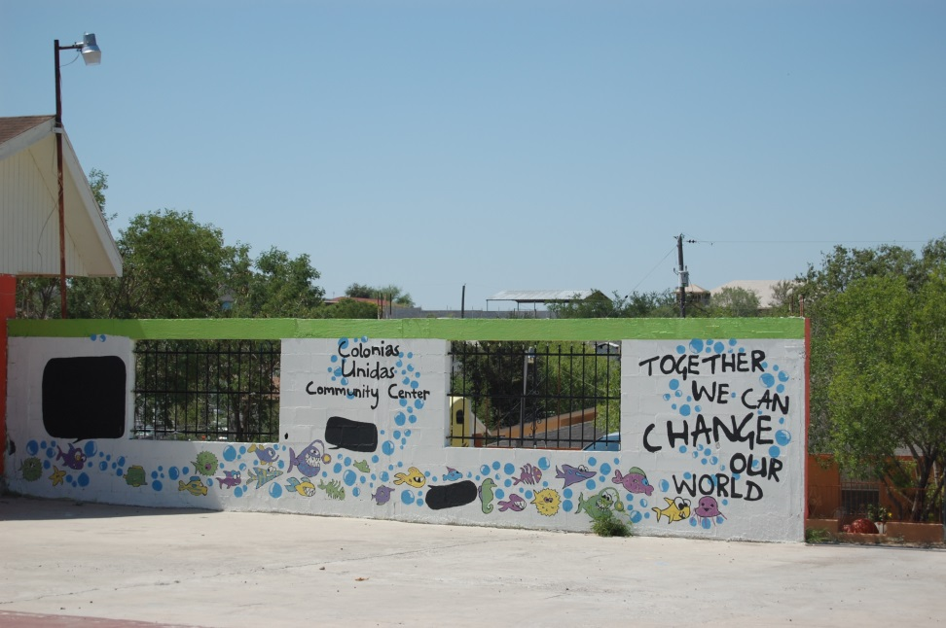
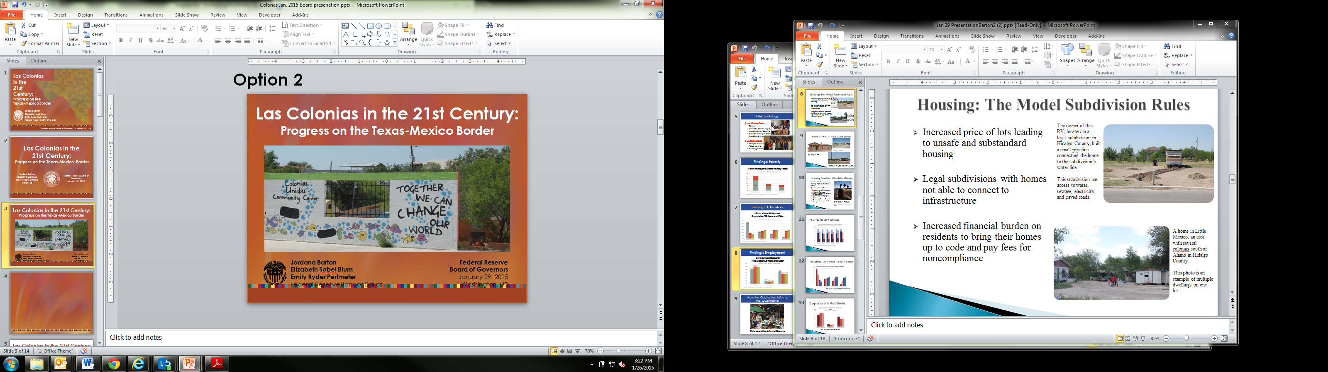
Closing the Digital Divide in the RGV:
Why Digital Equity is Vital for a Strong Economy
Digital Opportunity Collective Impact Team
Maria Vasquez, ACT
Jordana Barton
Federal Reserve Bank of Dallas
re+vitalize Place-Based
Initiative Symposium
November 17, 2015
Dallas, TX

Slide 2
Disclaimer
The views expressed in this presentation are the presenters and do not necessarily represent the views of the Federal Reserve Bank of Dallas or the Federal Reserve System.

Slide 3
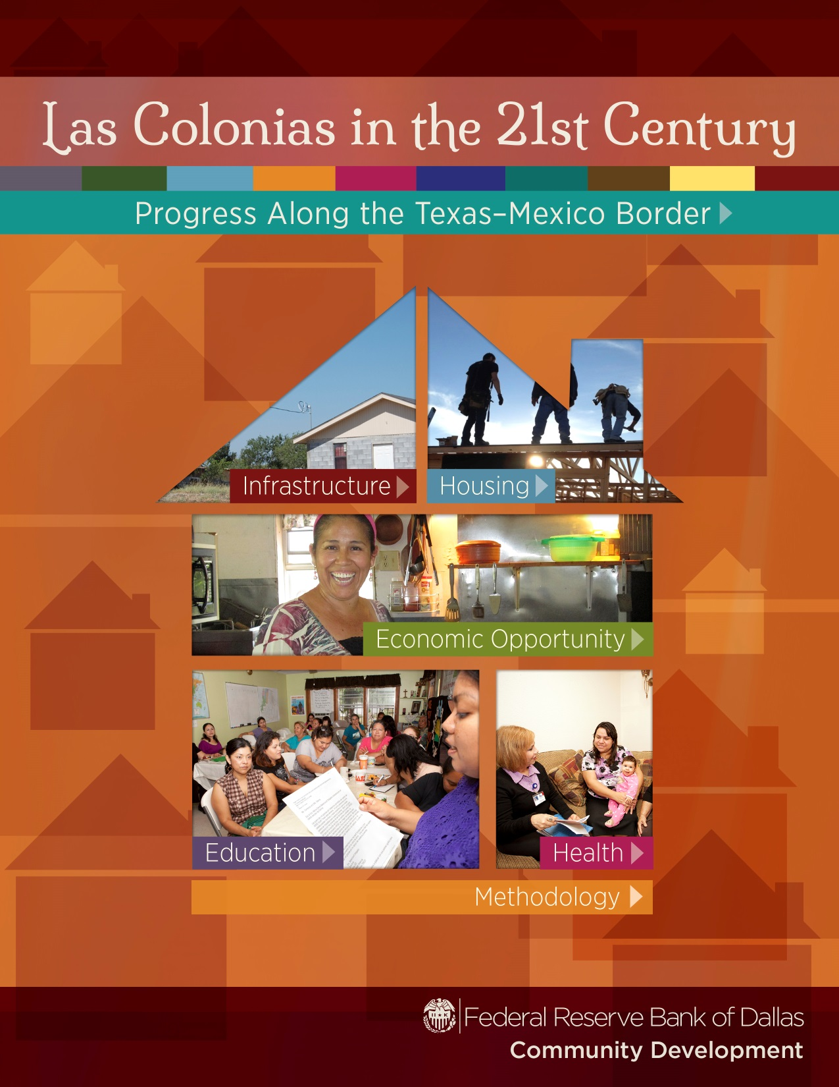

Slide 4
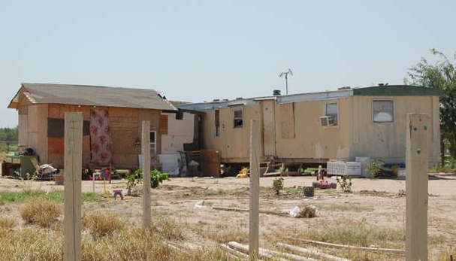
What is a Colonia?
In Spanish, the term "colonia" means a
community or neighborhood.
The Texas Office of the Secretary of State defines a colonia as a residential area along the Texas-Mexico border that may lack necessities such as potable water, sewer systems, electricity, paved roads and safe housing.

Slide 5
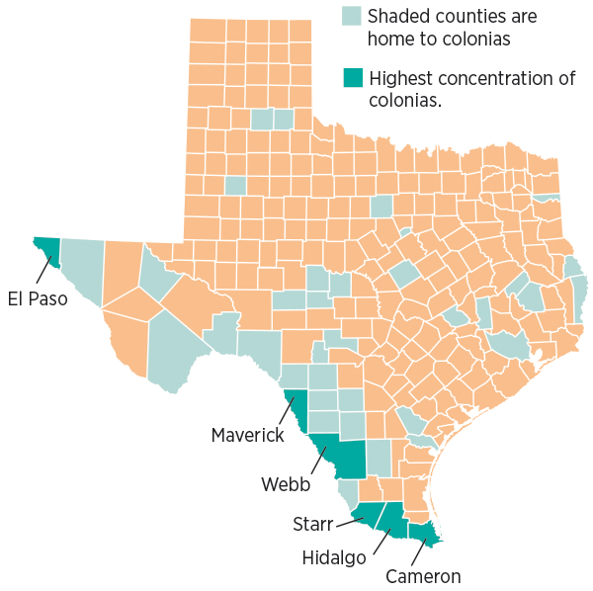
Counties with Colonias in Texas

Slide 6
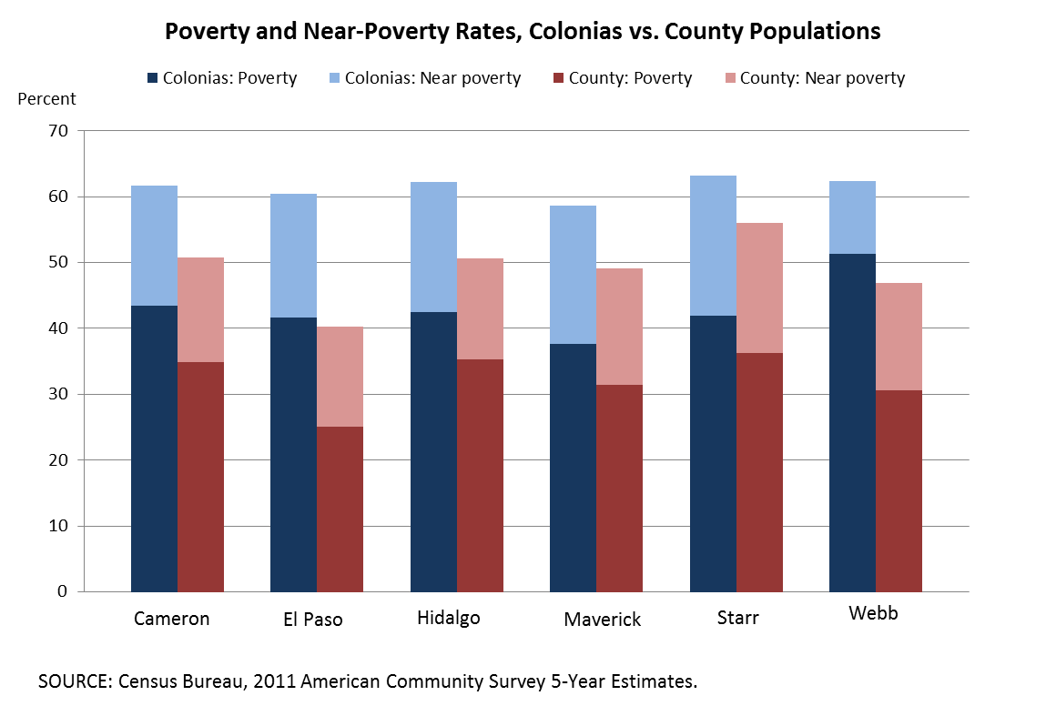
Poverty & Near-Poverty Rates
Colonias vs. County Populations

Slide 7
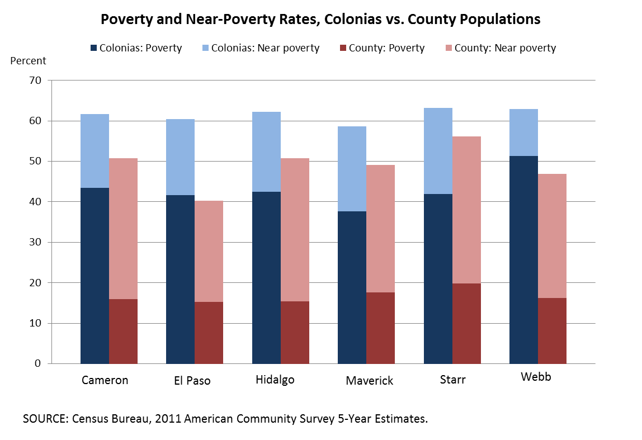
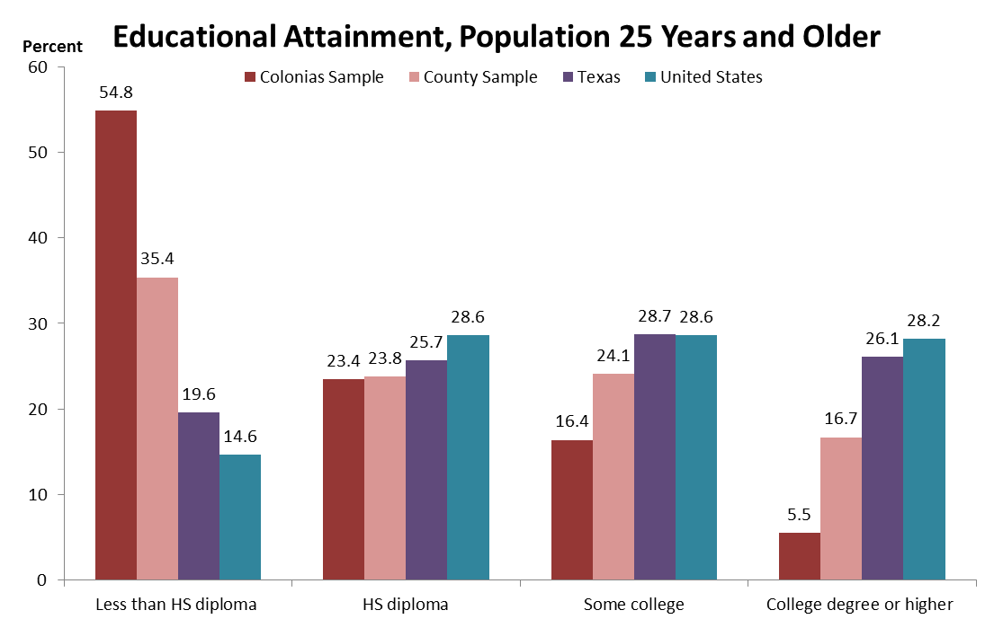
Educational Attainment
Population 25 Years and Older
SOURCE: U.S. Census Bureau, 2011 American Community Survey 5-Year Estimates
NOTE: HS diploma includes equivalency

Slide 8
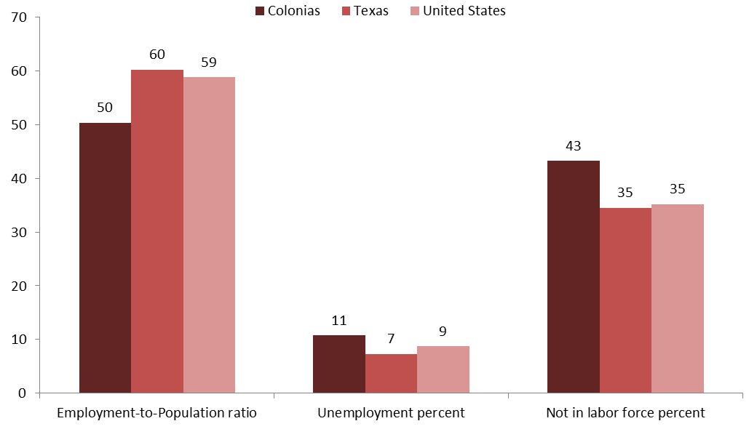
Employment Status
Population 16 Years and Older
Source: Census Bureau’s 2011 American Community Survey

Slide 9
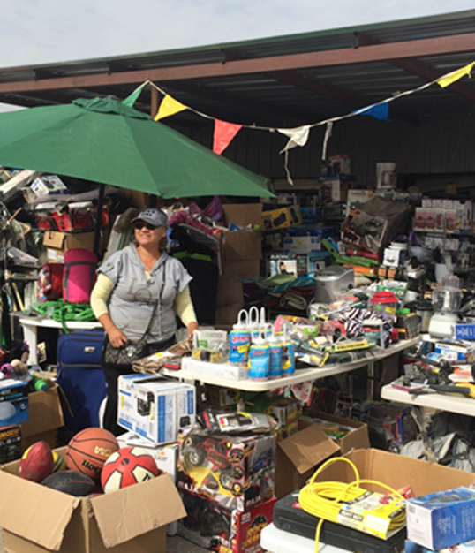
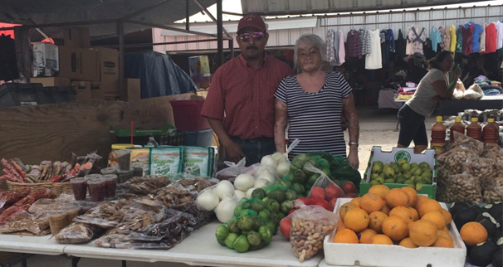
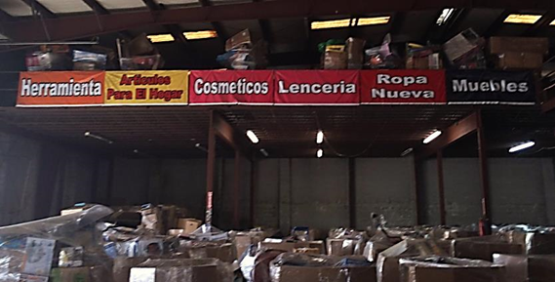
The Informal Economy: Pulgas
Photo credits: Accion Texas, Inc.

Slide 10
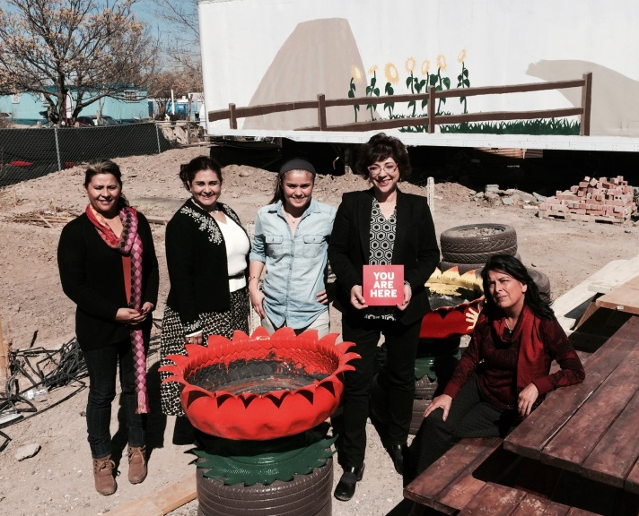
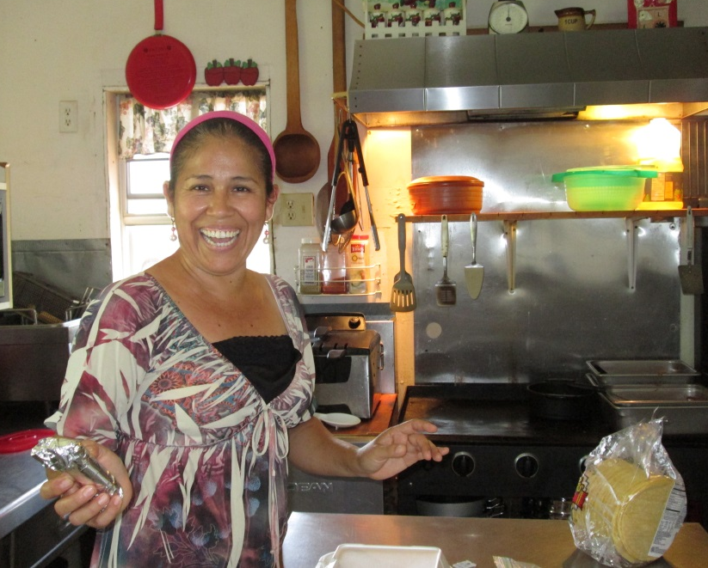
Colonia Resident Entrepreneurship
Leticia Jones in the kitchen of her restaurant, Leticia’s Comida Casera, in Garciasville, Starr County.
Photo credit: Accion Texas, Inc.
Research team with Olivia Figeroa of AYUDA in San Elizario, El Paso County and an example of a planter the colonia residents make from tires that are routinely dumped near the community.

Slide 11
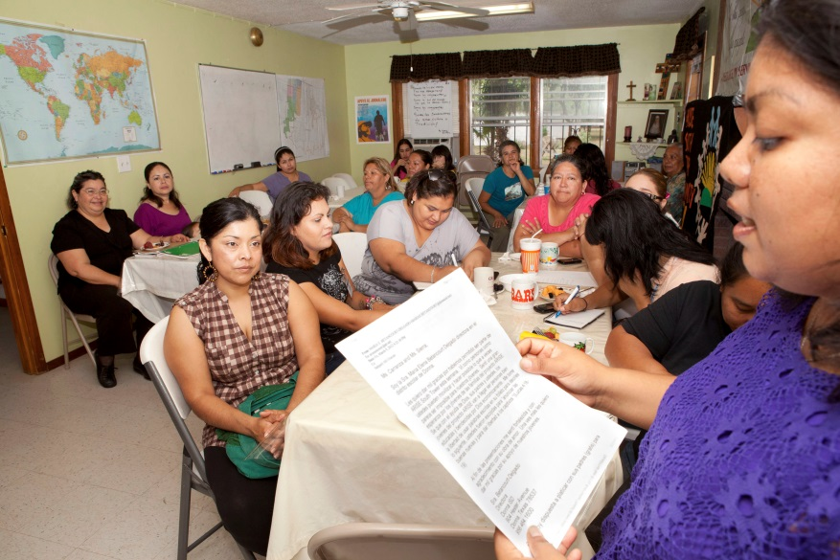
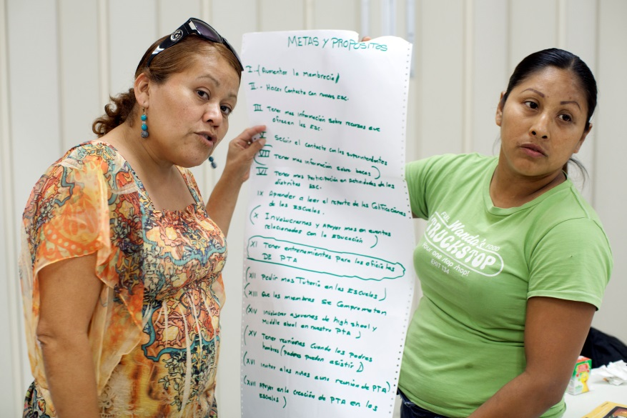
ARISE’S PTA Comunitario, Hidalgo Co.
Lourdes Flores, executive director of ARISE, facilitating their monthly meeting.
Photo credit: ARISE
Members present their goals and recommendations for ARISE at a meeting.
Photo credit: ARISE

Slide 12
Digital Divide on the Border
Of the 381 metropolitan areas in the US, those with the lowest rates of computer ownership and internet use by individuals include three Texas border MSAs.
Metropolitan Area | % With Computer | Regional Computer Gap* | % High-Speed Internet | Regional High-Speed Internet Gap*
Laredo | 69.3 | -22.7 | 51.8 | -31.0
Brownsville-Harlingen | 71.7 | -20.3 | 57.4 | -25.3
McAllen-Edinburg-Mission | 75.6 | -16.4 | 55.2 | -27.6
Austin-Round Rock* | 92.0 | 0.0 | 82.8 | 0.0
US Census Bureau, American Community Survey, 2013
Notes:
* Gaps are comparisons to highest % (Austin --Round Rock)

Slide 13
Digital equity must be central to community economic development
“Like electricity a century ago, broadband is a foundation for economic growth, job creation, global competitiveness and a better way of life. It is enabling entire new industries and unlocking vast new possibilities for existing ones. It is changing how we educate children, deliver health care, manage energy, ensure public safety, engage government, and access, organize and disseminate knowledge.”
(Federal Communications Commission, 2010)

Slide 14

Why are computer and Internet use important?
Commerce
Healthcare
Access to Banking
Government Services
Sharing information
Employment
Education
Workforce Development & Training

Slide 15
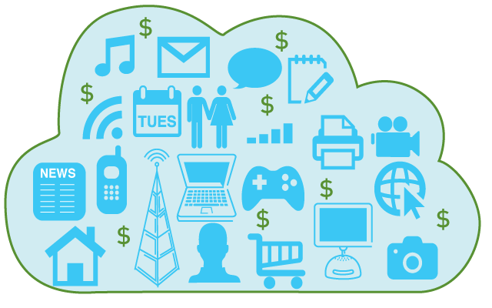
Digital Divide in the U.S.
The United States ranks 14th out of 34 developed and developing countries monitored by the OECD on broadband Internet penetration.
As an increasingly diverse array of essential resources are moved online, failure to address the lower levels of adoption among certain population groups causes them to fall behind economically, socially, and politically.
Notes:
Huffington Post, 2013. US has 68.2% percent of households with access to broadband Internet.

Slide 16
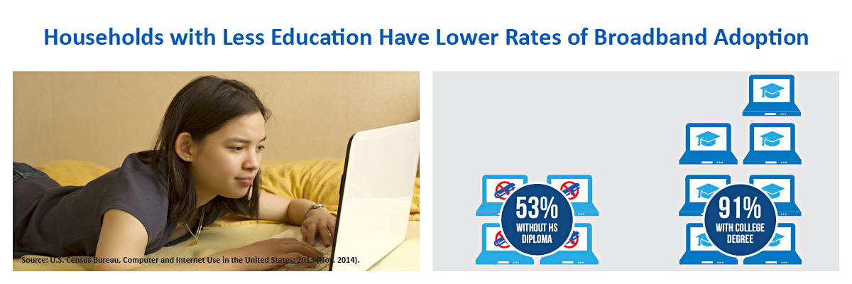
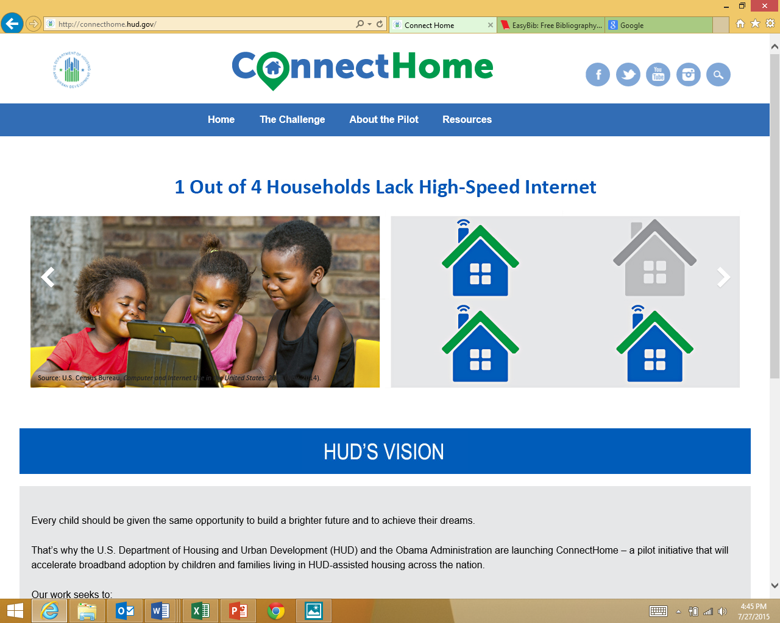
Digital Divide in the U.S.
Households with less education have lower rates of broadband adoption
1 out of 4 households lack high-speed Internet
Source: Department of Housing and Urban Development

Slide 17
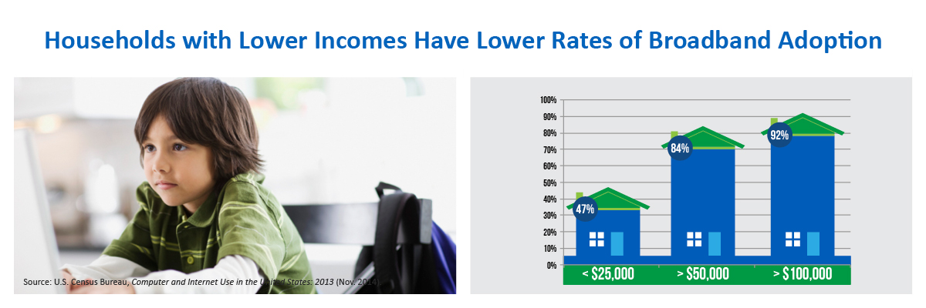
Digital Divide in the U.S.
Households with lower incomes have lower rates of broadband adoption
Source: Department of Housing and Urban Development
Households with lower incomes have lower rates of broadband adoption

Slide 18


Digital Divide in the U.S.
Over 100 million Americans, mostly low-income, lack affordable access to the Internet. Yet, access and skill in using the Internet safely and effectively have become essential for educational and economic opportunity. Over 80% of jobs are advertised only online.
84% of the nation’s K-12 teachers report that the digital divide is growing in their classrooms because of unequal access at home to essential learning technology resources.
Notes:
In the digital age, it is no longer a luxury to equip all children with literacy, technology and media literacy skills vital to lifelong educational and economic opportunity.

Slide 19
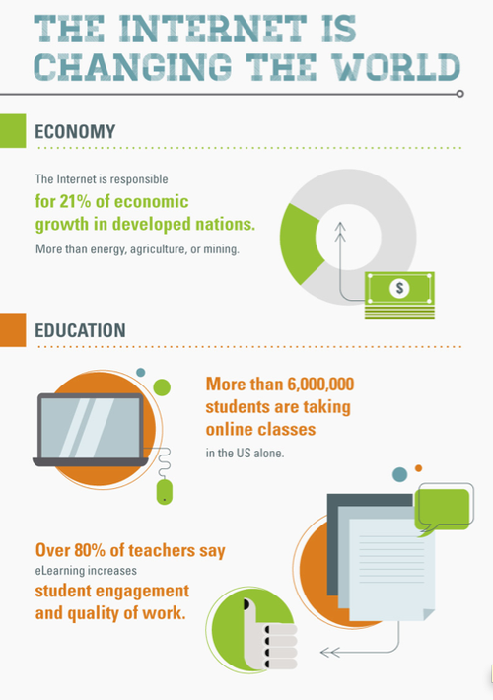
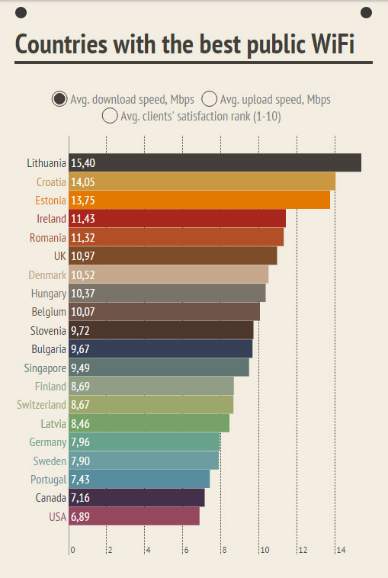
Digital Divide and the Economy
Information Technology & People, 2010
Notes:
In the digital age, it is no longer a luxury to equip all children with literacy, technology and media literacy skills vital to lifelong educational and economic opportunity.
Middleton, Karen L., and Valrie Chambers. "Approaching digital equity: is wifi the new leveler?." Information Technology & People 23.1 (2010): 4-22.

Slide 20
How does Internet access impact the economy?
Countries like Sweden, Switzerland, the U.K. and others that make digital connection and commerce easier for their populations have a much larger share of their economies represented by digital business — about 2.5 more percentage points.
Boston Consulting Group (BCG) tabulates that even during the post-financial-crisis recession, the digital economy was growing by about 8 percentage points a year.
Nationwide study finds high speed broadband access adds $5,437 to price of a $175,000 home (WSJ, July 6, 2015).
The crucial point is that the digital economy is growing exponentially faster than the real economy.
Notes:
digital economy (which includes not only e-commerce, but the cost of online access via broadband-subscription fees)
Source: Time Magazine, Jan 22, 2014

Slide 21
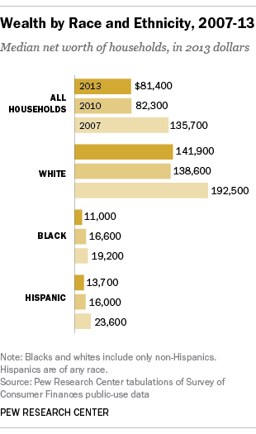
The Headlines: Worsening Wealth Inequality
Notes:
The extent of and continuing increase in inequality in the United States greatly concern me.” - Janet Yellen, Chair, Board of Governors of the Federal Reserve System

Slide 22
Rise in Inequality
The past several decades have seen the most sustained rise in inequality since the 19th Century.
Income and wealth inequality are near their highest levels in the past hundred years.
Federal Reserve’s Survey of Consumer Finances (Sept. 2014): The top 3% account for 30.5% of all income and hold 54.4% of all the net worth.
The Gatsby Curve: The finding that greater income inequality is associated with diminished intergenerational mobility.

Slide 23
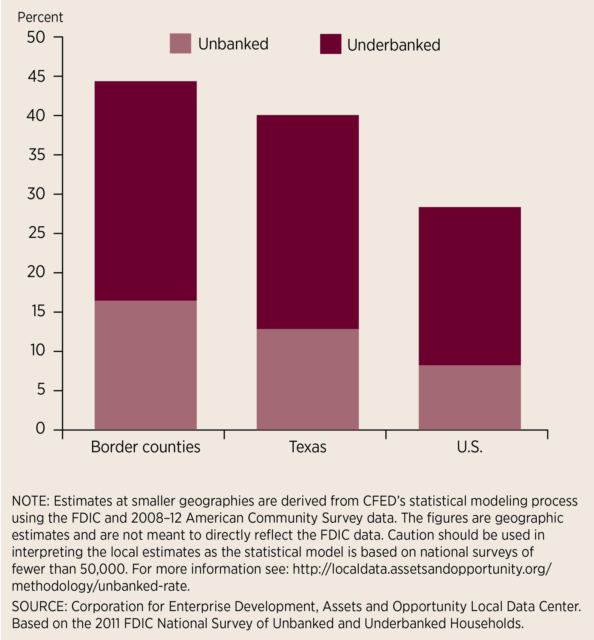
Unbanked & Underbanked
Six Texas Border Counties: Cameron, Hidalgo, Starr, Webb, Maverick, El Paso
Of the top 100 unbanked “places” (cities, towns, or census designated places with more than 250 households), 36 are in Texas.
Starr County, TX is the most unbanked county in the country -- 32.7% of households are unbanked and 28.2% of households are underbanked.
Of counties with more than 100,000 households, Hidalgo County, TX has the highest proportion of unbanked households (21.6%).
Notes:
Source: CFED- The Most Unbanked Places in America. https://cfed.org/newsroom/experts/ethan_geiling/the_most_unbanked_places_in_america/

Slide 24
DO4RGV
Digital Opportunity for the Rio Grande Valley Demonstration Project (DO4RGV) is a collective impact partnership to undertake a nationally significant nonprofit initiative to eliminate the digital divide for our lowest income children and their families by providing key resources for educational and economic opportunity and self-determination.
Partners to date:
Federal Reserve Bank of Dallas | ACT
University of Texas Rio Grande Valley | Dell
University of Texas at Austin | Kajeet
Capital One | Verizon
Health and Human Services Commission | City of Pharr
Doctors Hospital at Renaissance | City of McAllen
Pharr-San Juan-Alamo ISD La Joya ISD Region One Educational Service Center | Small Business Administration (SBA)
Notes:
Texas Association of Telecommunications Officers and Advisers

Slide 25
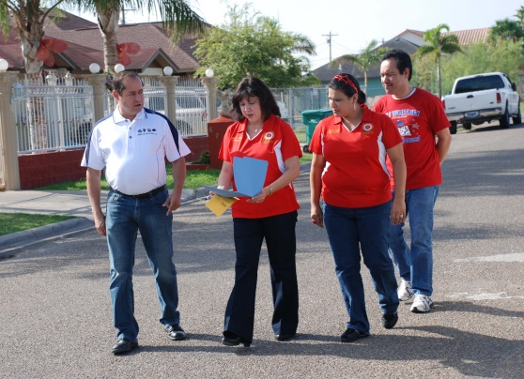
How we are going to do it?
Community led collective impact effort
Reach out to government agencies, foundations and companies to partner in the effort
Reach out to financial institutions for investment and support under the Community Reinvestment Act (CRA)
Deeply discounted home Internet
Discounted home laptop and tablet PCs
Bilingual Educational Content
Bilingual Tech Support
Digital Opportunity Corps (student IT experts )
Financing
Photo credit: PSJA ISD

Slide 26
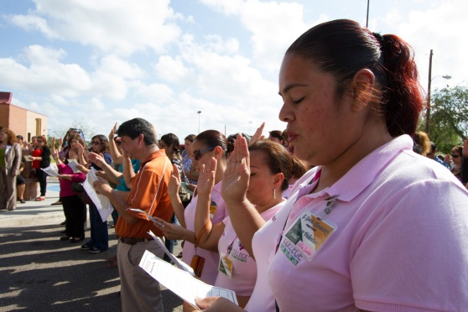
Project Scope
Tier 1-The demonstration project will be focused on students and their families within two school districts: Pharr-San Juan-Alamo ISD and La Joya ISD. It will focus on computer financing, broadband, bilingual training to ensure adoption and bilingual tech support. It will also provide educational content for youth and adults.
Tier 2-The group will work with municipal governments, internet companies, anchor institutions, and other stakeholders to provide broadband access more equitably.
Photo credit: PSJA ISD

Slide 27
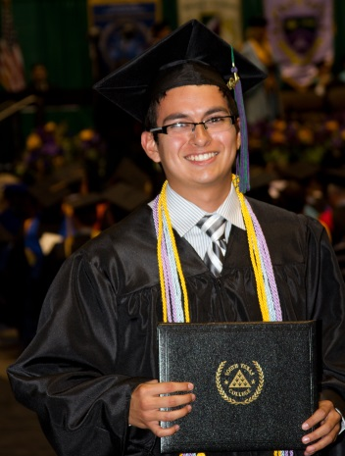
Project Objectives
To improve educational opportunity and results for our Pre K-12 students and their families across the region. Close the “homework divide”.
To improve access to workforce opportunities, including training and job opportunities.
To improve access to financial services and online banking.
To improve access to the internet and online marketing for micro entrepreneurs in the region.
To improve financial literacy through access to the Dallas Fed’s Building Wealth and Navigate curricula, as well as partner programs.
To improve access to Healthcare providers.
Photo credit: PSJA ISD

Slide 28
Q & A
DO4RGV Collective Impact Team
Maria Vasquez, ACT
Jordana Barton
Federal Reserve Bank of Dallas
re+vitalize Place-Based
Initiative Symposium
November 17, 2015
Dallas, TX

